Slide 1
Solving Problem by Searching : Uninformed Search
Solving Problem by Searching: Uninformed Search
Course Code: CSC4226
Dept. of Computer Science
Faculty of Science and Technology
Course Title: Artificial Intelligence and Expert System
Lecture No: | 3 | Week No: | 3 | Semester: | Summer 2023-24
Lecturer: | Prof. Dr. Firoz Ahmed fahmed@aiub.edu

Slide 2
Lecture Outline
Problem-Solving Agents
Example Problems
Searching for Solutions
Uninformed Search Strategies

Slide 3
PROBLEM SOLVING AGENTS
Simple Reflexive Agent
Base their action on a direct mapping from STATEs to ACTIONs Uses Rule
Goal Based Agent
Consider future Actions and the desirability of their outcomes
Problem Solving Agent
Goal based Agent
Use Atomic representation of Environment

Slide 4
Problem Solving Agent
The problem-solving agent performs precisely by defining problems and its several solutions.
According to psychology, “a problem-solving refers to a state where we wish to reach to a definite goal from a present state or condition.”
According to computer science, a problem-solving is a part of artificial intelligence which encompasses a number of techniques such as algorithms, heuristics to solve a problem.
Therefore, a problem-solving agent is a goal-driven agent and focuses on satisfying the goal.

Slide 5
Steps in problem solving
Goal Formulation
Problem Formulation
Search
Solution
Execution

Slide 6
GOAL FORMULATION
Goals help organize behavior by limiting the objectives that the agent is trying to achieve and hence the actions it needs to consider.
Goal formulation is the first step in problem solving. It is based on the current situation and the agent’s performance measure,
Goal: A set of world states—exactly those states in which the goal is satisfied.
The agent’s task is to find out how to act, now and in the future, so that it reaches a goal state.

Slide 7
Goal Formation
Goal Formulation:
It is the first and simplest step in problem-solving
It organizes the steps/sequence required to formulate one goal out of multiple goals as well as actions to achieve that goal
Goal formulation is based on the current situation and the agent’s performance measure

Slide 8
PROBLEM FORMULATION: BASED ON ENVIRONMENT
Problem formulation is the process of deciding what actions and states to consider, given a goal.
In an Unknown environment the agent will not know which of its possible actions is best, because it does not yet know enough about the state that results from taking each action.
If the agent has no additional information—i.e., if the environment is unknown in the sense defined in Section 2.3—then it is having no choice but to try one of the actions at random.
an agent with several immediate options of unknown value can decide what to do by first examining future actions that eventually lead to states of known value.

Slide 9
Problem Formation
It is the most important step of problem-solving which decides what actions should be taken to achieve the formulated goal
There are following five components involved in problem formulation
Initial State
It is the starting state or initial step of the agent towards its goal
For example, if a taxi agent needs to get to location(B) but the taxi is currently at location(A) then the initial state of the problem would be location(A)
Actions
It is the description of the possible actions available to the agent
Given a state s, Actions(s) returns the set of actions that can be executed in s
We say that each of these actions is applicable in s

Slide 10
Problem Formation
Transition Model
It describes what each action does
It is specified by a function Result(s, a) that returns the state that results from doing action a in state s
Goal Test
It determines if the given state is a goal state.
Path cost
It assigns a numeric cost to each path that follows the goal
The problem-solving agent selects a cost function, which reflects its performance measure
Remember, an optimal solution has the lowest path cost among all the solutions

Slide 11
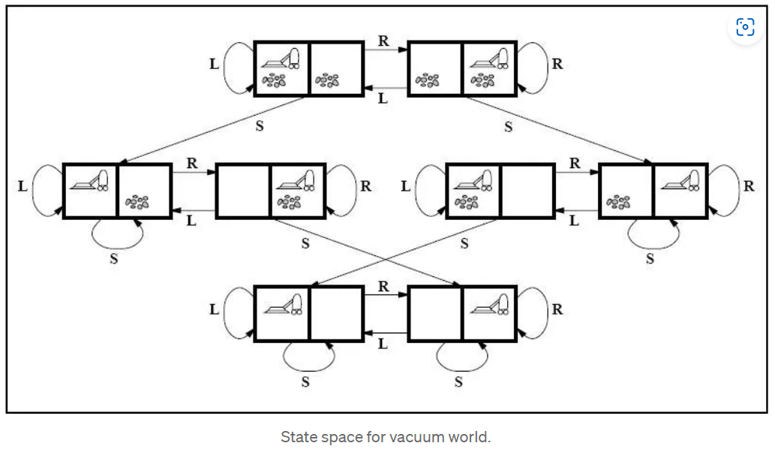
Problem Formation
An Example Problem Formulation
Let us take the example of vacuum world that was introduced in the starting of this series, There is a vacuum cleaner agent and it can move left or right and its jump is to suck up the dirt from the floor

Slide 12
Problem Formation
The problem for vacuum world can be formulated as follows:
_{States}
The state is determined by both the agent location and the dirt location
The agent is in one of two locations, each of which might or might not contain dirt
Therefore, there are 2 x 2² = 8 possible world states.
A larger environment would have n x 2 to the power of n states.
_{Initial State}
Any state can be assigned as the initial state in this case.
_{Action}
In this environment there are three actions, Move Left , Move Right , Suck up the dirt.

Slide 13
Problem Formation
The problem for vacuum world can be formulated as follows:
_{Transition Model}
All the actions have expected effects, except for when the agent is in leftmost square and the action is Left, when the agent is in rightmost square and the action is Right and the square is clean when the action is to Suck.
_{Goal Test}
Goal test checks whether all the squares are clean.
_{Path Cost}
Each step costs 1, so the path cost is the number of steps in the path.
The vacuum world problem is a toy problem and involves only discrete locations, discrete dirt etc. Therefore, this problem is a Toy Problem
There are many Real-World Problems like the automated taxi world
Try to formulate problems of real world and see what would be the states be and what actions could be chosen etc

Slide 14
Steps in problem solving
Search
It identifies all the best possible sequence of actions to reach the goal state from the current state
It takes a problem as an input and returns solution as its output.
Solution
It finds the best algorithm out of various algorithms, which may be proven as the best optimal solution.
Execution
It executes the best optimal solution from the searching algorithms to reach the goal state from the current state.

Slide 15
SEARCH-SOLUTION-EXECUTE
The process of looking for a sequence of actions that reaches the goal is called search
Solution is the sequence of actions that takes any agent to the goal state, exactly those state the agent is satisfied.
A search algorithm takes a problem as input and returns a solution in the form of an action sequence.

Slide 16
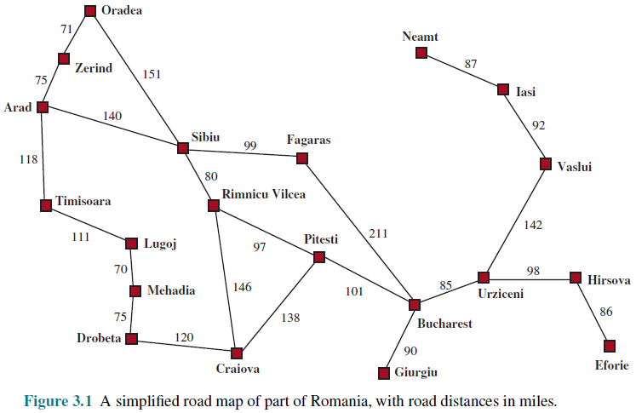
ROMANIAN MAP

Slide 17
Problem-solving in Artificial Intelligence | by Ritiksangam | Medium
rohini_62912743812.pdf (rcet.org.in)
Problem Solving Agents in Artificial Intelligence - Box Of Notes

Slide 18
SEARCH-SOLUTION-EXECUTE: OPEN LOOP SYSTEM
It is an important property that in a fully observable, deterministic, known environment, the solution to any problem is a fixed sequence of actions: drive to Sibiu, then Fagaras, then Bucharest.
If the model is correct, then once the agent has found a solution, it can ignore its percepts while it is executing the actions—closing its eyes, so to speak—because the solution is guaranteed to lead to the goal. Control theorists call this an open-loop system: ignoring the percepts breaks the loop between agent and environment.
If there is a chance that the model is incorrect, or the environment is nondeterministic, then the agent would be safer using a closed-loop approach that monitors the percepts

Slide 19
WELL-DEFINED PROBLEMS
A problem can be defined formally by five components:
1. The initial state that the agent starts in. For example, the initial state for our agent in Romania might be described as In(Arad).
2. A description of the possible actions available to the agent. Given a particular state s, ACTIONS(s) returns the set of actions that can be executed in s. We say that each of these actions is applicable in s. For example, from the state In(Arad), the applicable actions are {Go(Sibiu), Go(Timisoara), Go(Zerind)}.
3. A description of what each action does; the formal name for this is the transition model, specified by a function RESULT(s, a) that returns the state that results from doing action a in state s. We also use the term successor to refer to any state reachable from a given state by a single action.2 For example, we have RESULT(In(Arad),Go(Zerind)) = In(Zerind) .
4. The goal test, which determines whether a given state is a goal state.
5. A path cost function that assigns a numeric cost to each path.

Slide 20
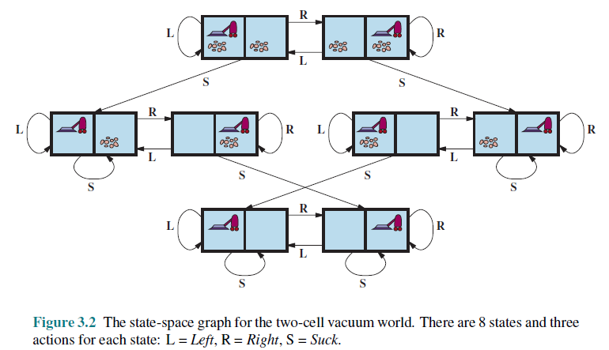
Vacuum World Problem

Slide 21
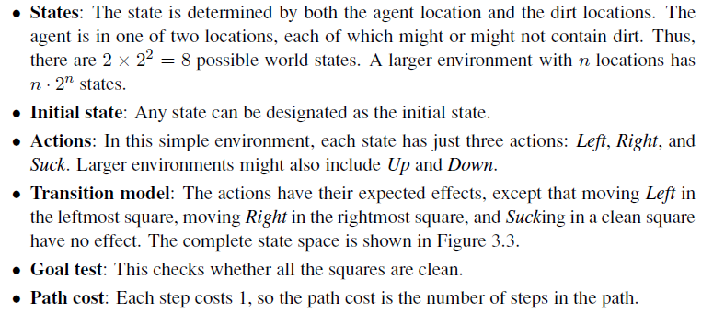
VACUUM WORLD: PROBLEM FORMULATION

Slide 22
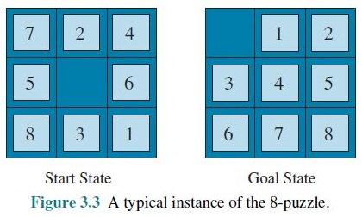
8-PUZZLE: PROBLEM FORMULATION

Slide 23
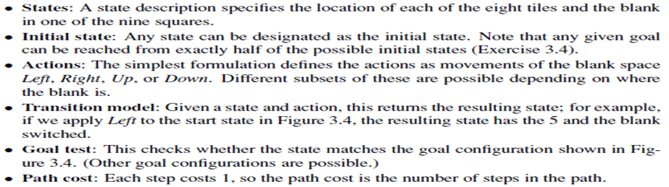
8-PUZZLE: PROBLEM FORMULATION

Slide 24

SEARCHING FOR SOLUTIONS
A solution is an action sequence, so search algorithms work by considering various possible action sequences
The possible action sequences starting at the initial state form a search tree with the initial state at the root; the branches are actions, and the nodes correspond to states in the state space of the problem.
Expanding the current state is, applying each legal action to the current state, thereby generating a new set of states

Slide 25
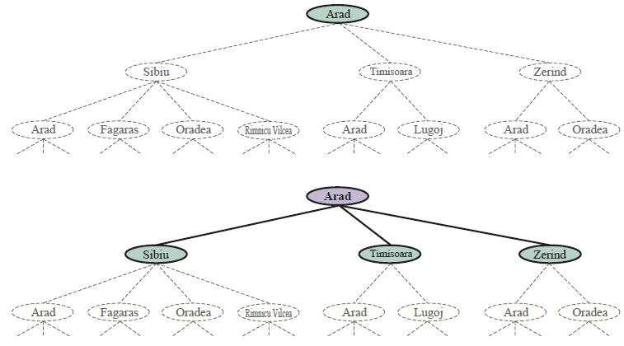
SEARCH TREE

Slide 26
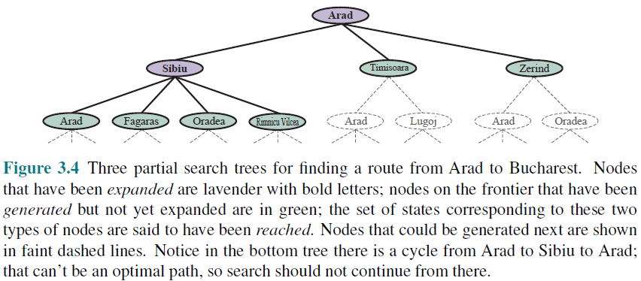
SEARCH TREE

Slide 27
SEARCH STRATEGY
the essence of search—following up one option now and putting the others aside for later, in case the first choice does not lead to a solution.
The set of all leaf nodes available for expansion at any given point is called the frontier.
The process of expanding nodes on the frontier continues until either a solution is found or there are no more states to expand.
Search algorithms all share this basic structure; they vary primarily according to how they choose which state to expand next —the so-called search strategy.

Slide 28
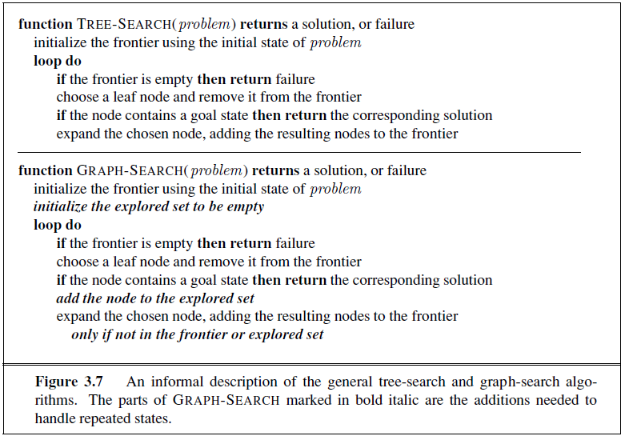
TREE SEARCH / GRAPH SEARCH

Slide 29
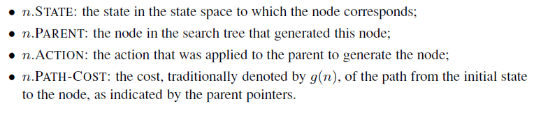
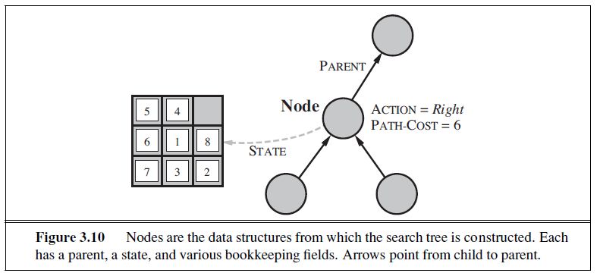
INFRASTRUCTURE FOR SEARCH ALGORITHMS

Slide 30
FRONTIER [FRINGE]
The frontier needs to be stored in such a way that the search algorithm can easily choose the next node to expand according to its preferred strategy. The appropriate data structure for this is a queue.
The operations on a queue are as follows:
• EMPTY(queue) returns true only if there are no more elements in the queue.
• POP(queue) removes the first element of the queue and returns it.
• INSERT(element, queue) inserts an element and returns the resulting queue.
Queues are characterized by the order in which they store the inserted nodes. Three common variants are -
the first-in, first-out For FIFO queue, which pops the oldest element of the queue;
the last-in, first-out or LIFO queue (also known as a stack), which pops the newest element of the queue; and
the priority queue,

Slide 31
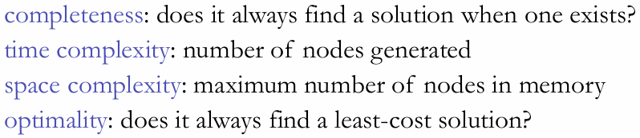
MEASURING PROBLEM-SOLVING PERFORMANCE

Slide 32
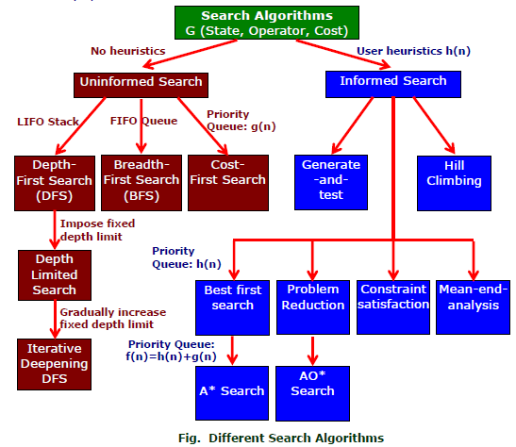
SEARCH ALGORITHMS

Slide 33
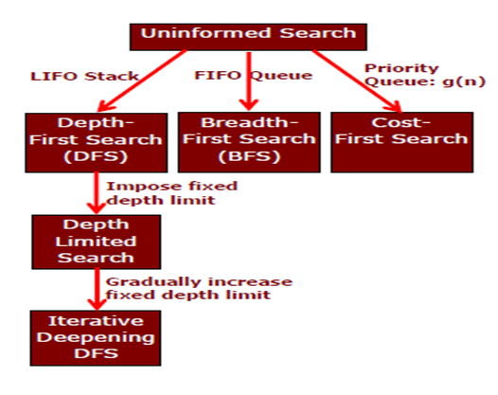
UNINFORMED SEARCH STRATEGIES

Slide 34
BREADTH-FIRST SEARCH
Breadth-first search is a simple strategy in which the root node is expanded first, then all the successors of the root node are expanded next, then their successors, and so on.
In general, all the nodes are expanded at a given depth in the search tree before any nodes at the next level are expanded.
Breadth-first search is an instance of the general graph-search algorithm (Figure 3.7) in which the shallowest unexpanded node is chosen for expansion.
This is achieved very simply by using a FIFO queue for the frontier.
Thus, new nodes (which are always deeper than their parents) go to the back of the queue, and old nodes, which are shallower than the new nodes, get expanded first.
The goal test is applied to each node when it is generated rather than when it is selected for expansion.
Following the general template for graph search, discards any new path to a state already in the frontier or explored set

Slide 35

Breadth-First Search
Breadth-first search is the most common search strategy for traversing a tree or graph
This algorithm searches breadthwise in a tree or graph, so it is called breadth-first search.
BFS algorithm starts searching from the root node of the tree and expands all successor node at the current level before moving to nodes of next level.
The breadth-first search algorithm is an example of a general-graph search algorithm.
Breadth-first search implemented using FIFO queue data structure.

Slide 36
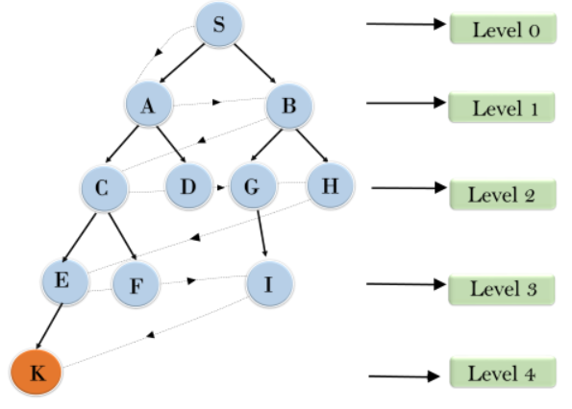
Breadth-First Search
S---> A--->B---->C--->D---->G--->H--->E---->F---->I---->K

Slide 37



Breadth-First Search
Time Complexity
Time Complexity of BFS algorithm can be obtained by the number of nodes traversed in BFS until the shallowest Node
Where the d= depth of shallowest solution and b is a node at every state.
T (b) = 1+b²+b³+.......+ b^{d}= O (b^{d})
Space Complexity
Space complexity of BFS algorithm is given by the Memory size of frontier which is O(b^{d}).
Completeness
BFS is complete, which means if the shallowest goal node is at some finite depth, then BFS will find a solution.
Optimality
BFS is optimal if path cost is a non-decreasing function of the depth of the node

Slide 38
Breadth First Search
Advantages:
BFS will provide a solution if any solution exists.
If there are more than one solutions for a given problem, then BFS will provide the minimal solution which requires the least number of steps.
Disadvantages:
It requires lots of memory since each level of the tree must be saved into memory to expand the next level.
BFS needs lots of time if the solution is far away from the root node.

Slide 39
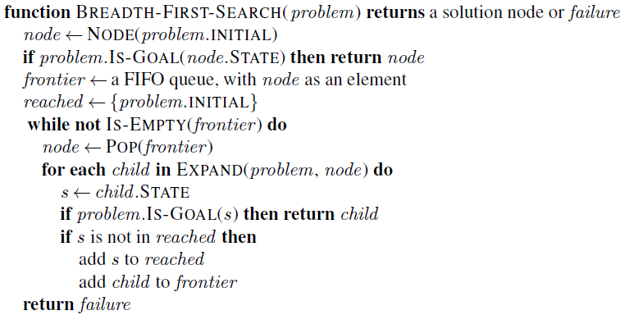
BREADTH-FIRST SEARCH: PSEUDOCODE

Slide 40
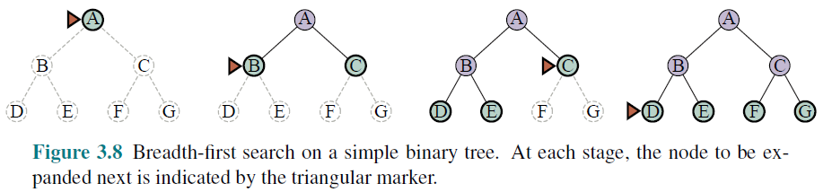

BREADTH-FIRST SEARCH: FOUR CRITERIA
complete—if the shallowest goal node is at some finite depth d, breadth-first search will eventually find it after generating all shallower nodes.
Breadth-first search is optimal if the path cost is a non-decreasing function of the depth of the node.
The time complexity would be O(b^{d+1}), The space complexity is O(b^{d})
For uniform tree, the total number of nodes generated is

Slide 41
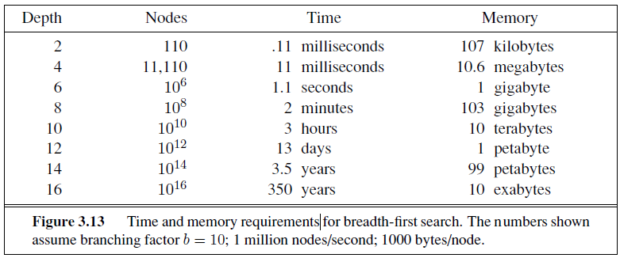
BREADTH-FIRST SEARCH: MEMORY REQUIREMENTS

Slide 42
Uniform Cost Search
Uniform-cost search is a searching algorithm used for traversing a weighted tree or graph
This algorithm comes into play when a different cost is available for each edge
The primary goal of the uniform-cost search is to find a path to the goal node which has the lowest cumulative cost
Uniform-cost search expands nodes according to their path costs form the root node
It can be used to solve any graph/tree where the optimal cost is in demand
A uniform-cost search algorithm is implemented by the priority queue
It gives maximum priority to the lowest cumulative cost
Uniform cost search is equivalent to BFS algorithm if the path cost of all edges is the same.

Slide 43
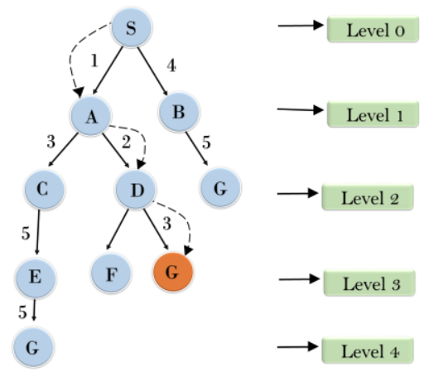

Uniform Cost Search

Slide 44
Uniform Cost Search
Completeness:
Uniform-cost search is complete, such as if there is a solution, UCS will find it.
Time Complexity:
Let C* is Cost of the optimal solution, and ε is each step to get closer to the goal node
Then the number of steps is = C*/ε+1. Here we have taken +1, as we start from state 0 and end to C*/ε.
Hence, the worst-case time complexity of Uniform-cost search isO(b1 + [C*/ε])/.
Space Complexity:
The same logic is for space complexity so, the worst-case space complexity of Uniform-cost search is O(b1 + [C*/ε]).
Optimal:
Uniform-cost search is always optimal as it only selects a path with the lowest path cost.

Slide 45
Uniform Cost Search
Advantages:
Uniform cost search is optimal because at every state the path with the least cost is chosen
Disadvantages:
It does not care about the number of steps involve in searching and only concerned about path cost
Due to which this algorithm may be stuck in an infinite loop.

Slide 46
UNIFORM-COST SEARCH
Instead of expanding the shallowest node, uniform-cost search expands the node n with the lowest path cost g(n).
This is done by storing the frontier as a priority queue ordered by g
Two other significant differences from breadth-first search are
The goal test is applied to a node when it is selected for expansion rather than when it is first generated
A test is added in case a better path is found to a node currently on the frontier.

Slide 47
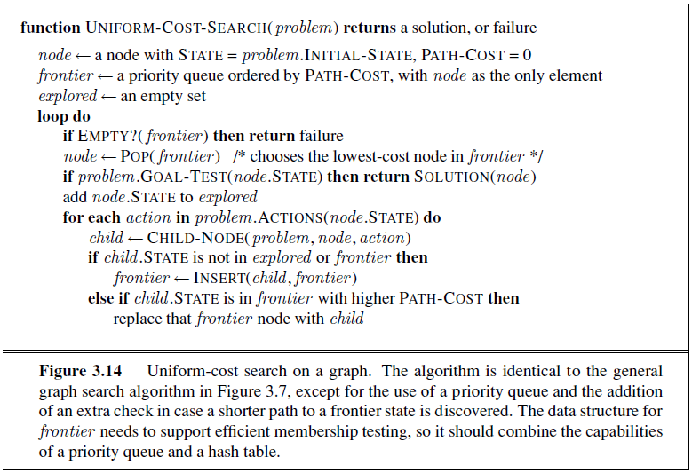
UNIFORM-COST SEARCH: PSEUDOCODE

Slide 48

UNIFORM-COST SEARCH: Arad → Bucharest
0
Arad
Arad
140
75
118
Sibiu
Timisoara
Sibiu
Zerind
Timisoara
Zerind
291
146
229
Oradea
Lugoj
Oradea
Lugoj
Oradea
Oradea
220
Rimnicu
Rimnicu
317
299
Mehadia
239
366
Mehadia
Pitesti
Fagaras
Pitestic
Fagaras
Craiova
Craiova
374
418
Drobeta
450
455
Bucharest
Drobeta
Bucharest
Bucharest
Craiova
486
Drobeta

Slide 49
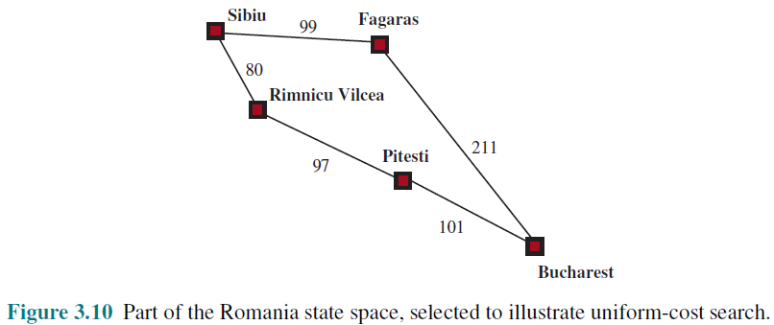
UNIFORM-COST SEARCH: ILLUSTRATION

Slide 50
UNIFORM-COST SEARCH: OPTIMALITY
Observe that whenever uniform-cost search selects a node n for expansion, the optimal path to that node has been found.
Were this not the case, there would have to be another frontier node n’ on the optimal path from the start node to n, n’ would have lower g-cost than n and would have been selected first
Then, because step costs are nonnegative, paths never get shorter as nodes are added
These two facts together imply that
uniform-cost search expands nodes in order of their optimal path cost.
Hence, the first goal node selected for expansion must be the optimal solution.

Slide 51
UNIFORM-COST SEARCH: COMPLETENESS & COMPLEXITY
Completeness is guaranteed provided the cost of every step exceeds some small positive constant ε.
Uniform-cost search is guided by path costs rather than depths, so its complexity is not easily characterized in terms of b and d.
Instead, let C* be the cost of the optimal solution, and assume that every action costs at least ε .
Then the algorithm’s worst-case time and space complexity is O(b ^{1+[C*/ε]}), which can be much greater than b^{d}.
When all step costs are equal, b ^{1+ [C∗/ε]} is just b^{d+1}.

Slide 52
Depth-First Search
Depth-first search is a recursive algorithm for traversing a tree or graph data structure
It is called the depth-first search because it starts from the root node and follows each path to its greatest depth node before moving to the next path
DFS uses a stack data structure for its implementation
The process of the DFS algorithm is similar to the BFS algorithm.

Slide 53
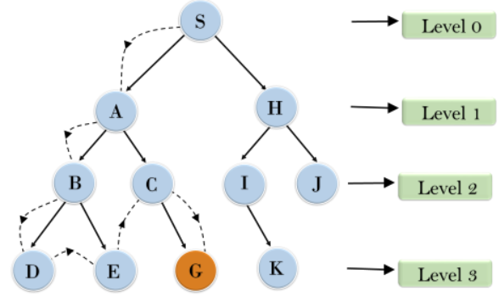
Depth-First Search
Root node--->Left node ----> right node
It will start searching from root node S, and traverse A, then B, then D and E, after traversing E, it will backtrack the tree as E has no other successor and still goal node is not found
After backtracking it will traverse node C and then G, and here it will terminate as it found goal node.

Slide 54
Depth-First Seatch
Time Complexity
Time complexity of DFS will be equivalent to the node traversed by the algorithm. It is given by:
T(n)= 1+ n2+ n3 +.........+ nm=O(nm)
Where, m= maximum depth of any node and this can be much larger than d (Shallowest solution depth)
Space Complexity
Space complexity of BFS algorithm is given by the Memory size of frontier which is O(b^{d}).\
DFS algorithm needs to store only single path from the root node, hence space complexity of DFS is equivalent to the size of the fringe set, which is O(bm).
Completeness
DFS search algorithm is complete within finite state space as it will expand every node within a limited search tree.
Optimality
DFS search algorithm is non-optimal, as it may generate a large number of steps or high cost to reach to the goal node.

Slide 55
Depth First Search
Advantages:
DFS requires very less memory as it only needs to store a stack of the nodes on the path from root node to the current node.
It takes less time to reach to the goal node than BFS algorithm (if it traverses in the right path).
Disadvantages:
There is the possibility that many states keep re-occurring, and there is no guarantee of finding the solution.
DFS algorithm goes for deep down searching and sometimes it may go to the infinite loop.

Slide 56
DEPTH-FIRST SEARCH
Depth-first search always expands the deepest node in the current frontier of the search tree.
The search proceeds immediately to the deepest level of the search tree, where the nodes have no successors
As those nodes are expanded, they are dropped from the frontier, so then the search “backs up” to the next deepest node that still has unexplored successors.
The depth-first search algorithm is an instance of the graph-search algorithm, where it uses a LIFO queue

Slide 57
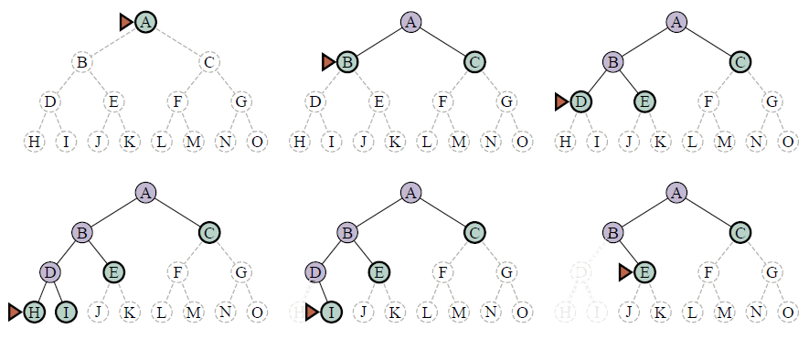
DEPTH-FIRST SEARCH: SEARCH TREE

Slide 58
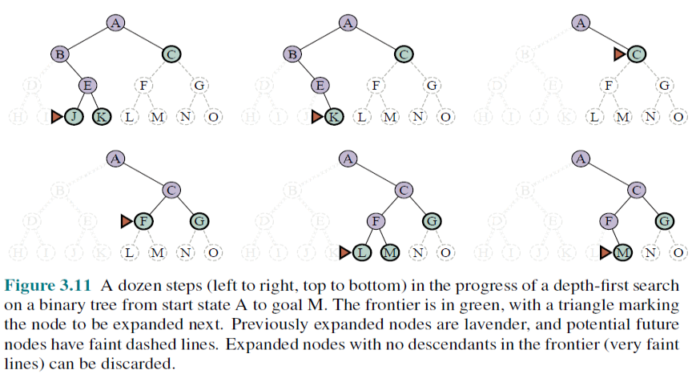
DEPTH-FIRST SEARCH: SEARCH TREE

Slide 59
DEPTH-FIRST SEARCH: Optimality, Complexity, Completeness
The graph-search version is complete in finite state spaces because it will eventually expand every node. The tree-search version, on the other hand, is not complete
Both versions are nonoptimal. For example, in Figure 3.16, depth first search will explore the entire left subtree even if node C is a goal node. If node J were also a goal node, then depth-first search would return it as a solution instead of C, which would be a better solution; hence, depth-first search is not optimal.
A depth-first tree search, may generate all of the O(b^{m}) nodes in the search tree, where m is the maximum depth of any node; this can be much greater than the size of the state space.
For a state space with branching factor b and maximum depth m, depth-first search requires storage of only O(bm) nodes.

Slide 60
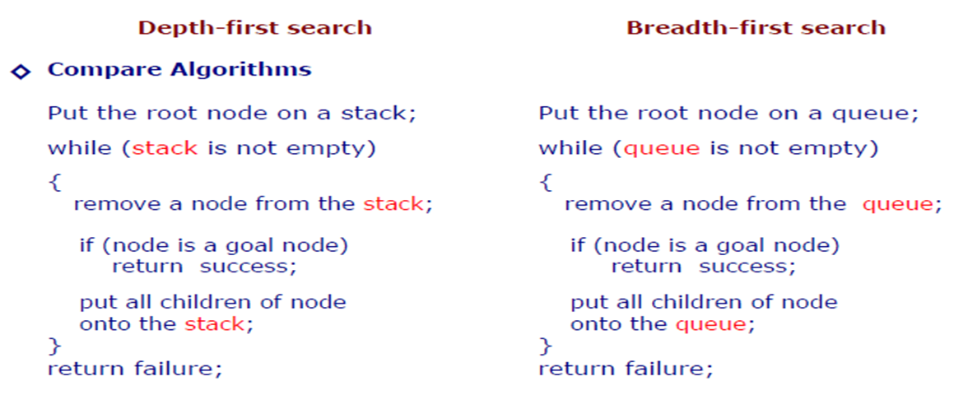
DFS v/s BFS

Slide 61
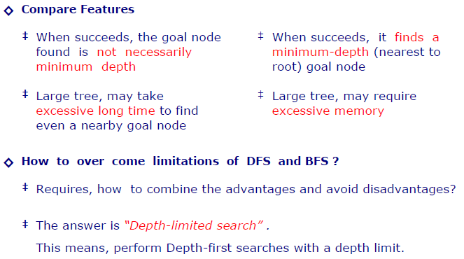
DFS v/s BFS

Slide 62
Depth-Limited Search
A depth-limited search algorithm is similar to depth-first search with a predetermined limit
Depth-limited search can solve the drawback of the infinite path in the Depth-first search. In this algorithm, the node at the depth limit will treat as it has no successor nodes further
Depth-limited search can be terminated with two Conditions of failure:
Standard failure value: It indicates that problem does not have any solution.
Cutoff failure value: It defines no solution for the problem within a given depth limit.

Slide 63
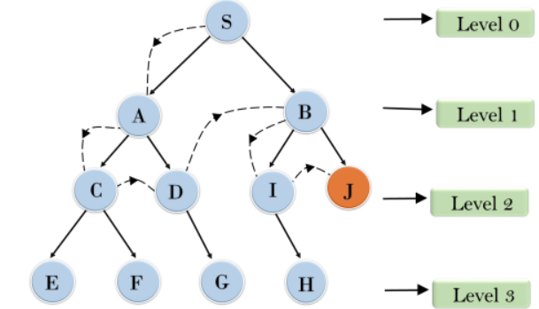
Depth-Limited Search

Slide 64
Depth-Limited Search
Time Complexity
Time complexity of DFS will be equivalent to the node traversed by the algorithm. It is given by:
T(n)= 1+ n2+ n3 +.........+ nm=O(nm)
Where, m= maximum depth of any node and this can be much larger than d (Shallowest solution depth)
Space Complexity
Space complexity of BFS algorithm is given by the Memory size of frontier which is O(b^{d}).\
DFS algorithm needs to store only single path from the root node, hence space complexity of DFS is equivalent to the size of the fringe set, which is O(bm).
Completeness
DFS search algorithm is complete within finite state space as it will expand every node within a limited search tree.
Optimality
DFS search algorithm is non-optimal, as it may generate a large number of steps or high cost to reach to the goal node.

Slide 65
Depth-Limited Seatch
Advantages:
Depth-limited search is Memory efficient.
Disadvantages:
Depth-limited search also has a disadvantage of incompleteness.
It may not be optimal if the problem has more than one solution.

Slide 66
DEPTH-LIMITED SEARCH
The embarrassing failure of depth-first search in infinite state spaces can be alleviated by supplying depth-first search with a predetermined depth limit .
That is, nodes at depth are treated as if they have no successors.
This approach is called depth-limited search
Depth-limited search will also be nonoptimal if we choose l> d. Its time complexity is O(b^{l}) and its space complexity is O(bl).
Depth-first search can be viewed as a special case of depth-limited search with l=∞.

Slide 67
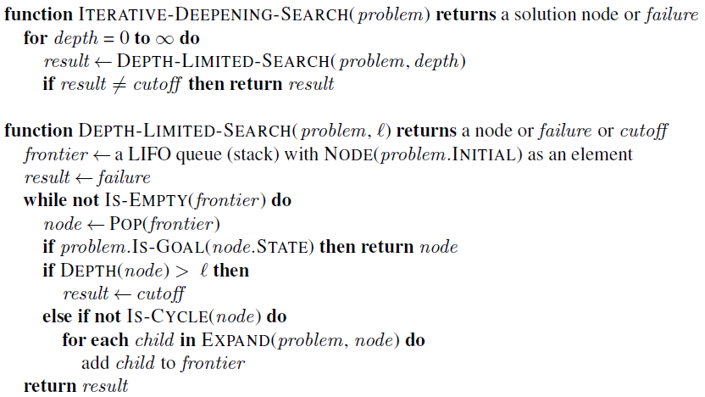
DEPTH-LIMITED SEARCH: PSEUDOCODE

Slide 68
Iterative Deepening Depth-First Search
The iterative deepening algorithm is a combination of DFS and BFS algorithms
This search algorithm finds out the best depth limit and does it by gradually increasing the limit until a goal is found.
This algorithm performs depth-first search up to a certain "depth limit", and it keeps increasing the depth limit after each iteration until the goal node is found.
This Search algorithm combines the benefits of Breadth-first search's fast search and depth-first search's memory efficiency.
The iterative search algorithm is useful uninformed search when search space is large, and depth of goal node is unknown.

Slide 69
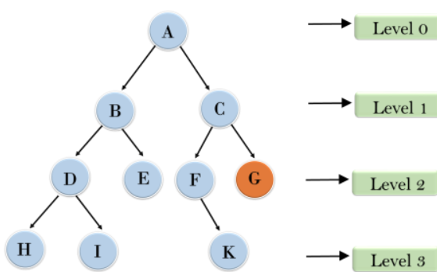
Iterative Deepening Depth-First Search
1'st Iteration-----> A
2'nd Iteration----> A, B, C
3'rd Iteration------>A, B, D, E, C, F, G
4'th Iteration------>A, B, D, H, I, E, C, F, K, G

Slide 70
Iterative Deepening Depth-First Search
Time Complexity
Let's suppose b is the branching factor and depth is d then the worst-case time complexity is O(bd).
Space Complexity
The space complexity of IDDFS will be O(bd).
Completeness
This algorithm is complete is if the branching factor is finite.
Optimality
IDDFS algorithm is optimal if path cost is a non- decreasing function of the depth of the node.

Slide 71
Iterative Deepening Depth-First Search
Advantages:
It combines the benefits of BFS and DFS search algorithm in terms of fast search and memory efficiency.
Disadvantages:
The main drawback of IDDFS is that it repeats all the work of the previous phase.

Slide 72
ITERATIVE DEEPENING DEPTH-FIRST SEARCH
Iterative deepening search (or iterative deepening depth-first search) is a general strategy, often used in combination with depth-first tree search, that finds the best depth limit.
It does this by gradually increasing the limit—first 0, then 1, then 2, and so on—until a goal is found
Iterative deepening combines the benefits of depth-first and breadth-first search.
Like depth-first search, its memory requirements are modest: O(bd) to be precise.
Like breadth-first search, it is complete when the branching factor is finite and optimal when the path cost is a nondecreasing function of the depth of the node

Slide 73
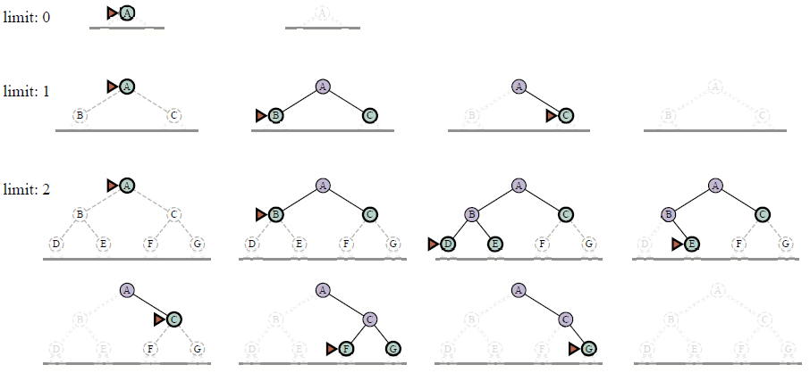
ITERATIVE DEEPENING DEPTH-FIRST SEARCH TREE

Slide 74
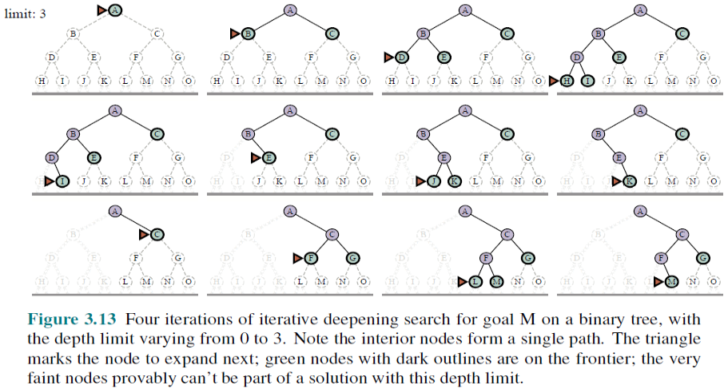
ITERATIVE DEEPENING DEPTH-FIRST SEARCH TREE

Slide 75

IDP: COMPLEXITY
Iterative deepening search may seem wasteful because states are generated multiple times. It turns out this is not too costly.
The reason is that in a search tree with the same (or nearly the same) branching factor at each level, most of the nodes are in the bottom level, so it does not matter much that the upper levels are generated multiple times.
In an iterative deepening search, the nodes on the bottom level (depth d) are generated once, those on the next-to-bottom level are generated twice, and so on, up to the children of the root, which are generated d times.
So the total number of nodes generated in the worst case is

Slide 76
Bidirectional Search
Bidirectional search algorithm runs two simultaneous searches, one form initial state called as forward-search and other from goal node called as backward-search, to find the goal node
Bidirectional search replaces one single search graph with two small subgraphs in which one starts the search from an initial vertex and other starts from goal vertex
The search stops when these two graphs intersect each other.
Bidirectional search can use search techniques such as BFS, DFS, DLS, etc

Slide 77
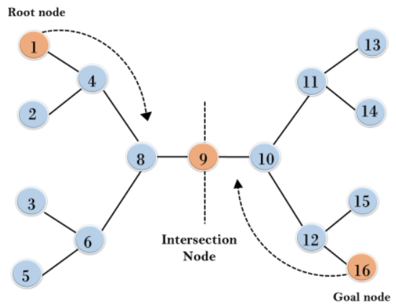
Bidirectional Search
In the below search tree, bidirectional search algorithm is applied
This algorithm divides one graph/tree into two sub-graphs
It starts traversing from node 1 in the forward direction and starts from goal node 16 in the backward direction.
The algorithm terminates at node 9 where two searches meet.

Slide 78
Bidirectional Search
Time Complexity
Let's suppose b is the branching factor and depth is d then the worst-case time complexity is O(bd).
Space Complexity
The space complexity of IDDFS will be O(bd).
Completeness
This algorithm is complete is if the branching factor is finite.
Optimality
IDDFS algorithm is optimal if path cost is a non- decreasing function of the depth of the node.

Slide 79
Bidirectional Search
Advantages:
Bidirectional search is fast.
Bidirectional search requires less memory
Disadvantages:
Implementation of the bidirectional search tree is difficult.
In bidirectional search, one should know the goal state in advance.

Slide 80
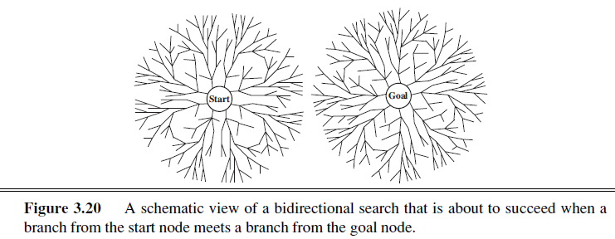
BIDIRECTIONAL SEARCH
The idea behind bidirectional search is to run two simultaneous searches—one forward from the initial state and the other backward from the goal—hoping that the two searches meet in the middle
Bidirectional search is implemented by replacing the goal test with a check to see whether the frontiers of the two searches intersect;

Slide 81
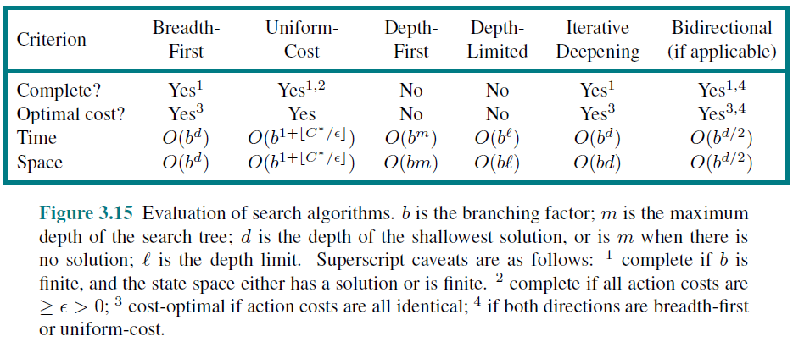

COMPARING UNINFORMED SEARCH STRATEGIES
This comparison is for tree-like search versions which don’t check for repeated states. For graph searches which do check, the main differences are that depth-first search is complete for finite state spaces.

Slide 82
References
Chapter 3: Solving Problem by Searching , Pages 64-91
“Artificial Intelligence: A Modern Approach,” by Stuart J. Russell and Peter Norvig,

Slide 83
Books
“Artificial Intelligence: A Modern Approach,” by Stuart J. Russell and Peter Norvig.
"Artificial Intelligence: Structures and Strategies for Complex Problem Solving", by George F. Luger, (2002)
"Artificial Intelligence: Theory and Practice", by Thomas Dean.
"AI: A New Synthesis", by Nils J. Nilsson.
“Programming for machine learning,” by J. Ross Quinlan,
“Neural Computing Theory and Practice,” by Philip D. Wasserman, .
“Neural Network Design,” by Martin T. Hagan, Howard B. Demuth, Mark H. Beale, .
“Practical Genetic Algorithms,” by Randy L. Haupt and Sue Ellen Haupt.
“Genetic Algorithms in Search, optimization and Machine learning,” by David E. Goldberg.
"Computational Intelligence: A Logical Approach", by David Poole, Alan Mackworth, and Randy Goebel.
“Introduction to Turbo Prolog”, by Carl Townsend.

